Slide 1


Liberty Lake
Climate Partners Advisory Team—Meeting 2
Note – images sourced as “Courtesy” may need request if used for final document…other images from 2016 Comp Plan

Slide 2
Agenda
Agenda
Introductions
Climate element process and engagement overview
Resiliency presentation and Q&A
Finalize Vision Statement
Next Steps

Slide 3
Process Overview
GHG inventory
Analysis/ Assessment
Data Gathering
Identify emissions reduction targets
Establish Goals
Plan Integration
Climate Element goals/policies
Integrated Comprehensive Plan
GHG Emissions Sub-element
Assess impacts and review existing plans
Assess vulnerability
Resilience
Sub-element
Other Comprehensive Plan Elements
Updates to other comprehensive plan elements
Engagement
Community engagement activities at key points throughout the process

Slide 4
Agenda
CPAT Engagement Overview
CPAT Meeting | Meeting Goals | Timeframe
1 | Approve Charter Learn about Liberty Lake's GHG profile Begin drafting vision statement | 1/28/2025
2 | Process overview Vision statement wrap up Adaptation & resilience overview | 2/24/2025
3 | Provide feedback on resiliency actions | Early April
4 | Provide feedback on GHG actions | Late April
5 | Wrap up meeting for final Climate Element review | August or October, TBD
Notes:
Last time:
Approved Charter
Learned about Liberty Lake’s GHG profile
Began drafting vision statement
This time:
Learn about climate resilience sub-element
Finalize vision statement
Future meetings:
Review resiliency memo
Review GHG emissions reduction memo
Review GHG emissions reduction actions
Review resiliency actions
Review final Climate Element, wrap up

Slide 5
CLIMATE RESILIENCE IN LIBERTY LAKE

Slide 6
What is the “Climate Element”?
What is the “Climate Element”?
RCW 36.70A.070 Comprehensive plans—Mandatory elements.
“A climate change and resiliency element that is designed to result in reductions in overall greenhouse gas emissions and that must enhance resiliency to and avoid the adverse impacts of climate change, which must include efforts to reduce localized greenhouse gas emissions and avoid creating or worsening localized climate impacts to vulnerable populations and overburdened communities.”
https://app.leg.wa.gov/RCW/default.aspx?cite=36.70A.070&pdf=true
  Washington State now requires planning for climate change in the Comprehensive Planning process.
  Climate Element includes two sub-elements
  GHG Emissions Reduction sub-element
  Resilience sub-element
  Communities are also required to advance environmental justice and avoid environmental health disparities.
Notes:
Reminder of what the Climate Element is and what it’s key components are.
Last time we focused on the GHG emissions reduction component when we went over the GHG emissions inventory results.
Today’s presentation will focus on the resilience and adaptation component.

Slide 7
MINIMUM REQUIREMENTS
Requirement 1: Address natural hazards created or aggravated by climate change, including sea level rise, landslides, flooding, drought, heat, smoke, wildfire, and other effects of changes to temperature and precipitation patterns
Requirement 2: Identify, protect, and enhance natural areas to foster climate resilience, as well as areas of vital habitat for safe species migration
Requirement 3: Identify, protect, and enhance community resilience to climate impacts, including social, economic, and built-environment factors, which support adaptation to climate impacts consistent with environmental justice
Notes:
John
Make sure to mention that this is a mandated element

Slide 8
METHODOLOGY & DATA
  Key data and information resources
    UW Climate Impacts Group (CMR tool, data for Climate Vulnerability map)
    Washington DNR WUI Maps
    Washington Department of Ecology
    US Geological Survey (USGS)
    Spokane County
    FEMA Risk Index
    WA State Health Disparities Map
    American Community Survey (Census Bureau)
    Center for Disease Control (CDC)
    Input from staff
  Following Commerce guidance for Climate Element
Notes:
John

Slide 9
METHODOLOGY & DATA
  Key data and information resources
    UW Climate Impacts Group (CMR tool, data for Climate Vulnerability map)
    Washington DNR WUI Maps
    Washington Department of Ecology
    US Geological Survey (USGS)
    Spokane County
    FEMA Risk Index
    WA State Health Disparities Map
    American Community Survey (Census Bureau)
    Center for Disease Control (CDC)
    Input from staff
  Following Commerce guidance for Climate Element

Slide 10



CLIMATE HAZARDS
C
 | Climate Projection (Key indicators from CMR Tool) | By 2050s* | By 2080s* | Notes
 | Total annual precipitation (percent change) | 8% increase (5 to 14 %) | 15% increase (7 to 24 %) | Annual precipitation will change slightly, but less rain in the summer. Less rain during warmer months
 | Late summer precipitation | 10% decrease (-25% - +8%) | 8% decrease (-31% - +30%)
 | Change in 24-hour 25 –year precipitation | 9% increase (0-24%) | 18% increase (11-46%)
 | Change in Hot Days (<100 °F). | 6 days (2 – 10) | 24 days (12 - 40) | Increase in summer temperatures impacts human health. Ecosystem impacts (particularly outside of forested areas) Increased energy demand for summer cooling
 | 90 Degree Max. Humidex (change in days) Historic 21 days | 23 (11 - 34) | 55 (34 - 77)
 | 65 Degree Min. Humidex (change in days) historic 5 days | 13 (7 - 21) | 37 (17 - 59)
 | Wildfire – Change in high fire days – 53 days historical (1971-2000) | 10 additional days (3 – 17 days) |  | Potential for wildfire to damage infrastructure, disrupt business, and affect health and well-being
Notes:
Current 25-year 24 hour is 1.5 inches
Summer average is 2.0 inches

Slide 11
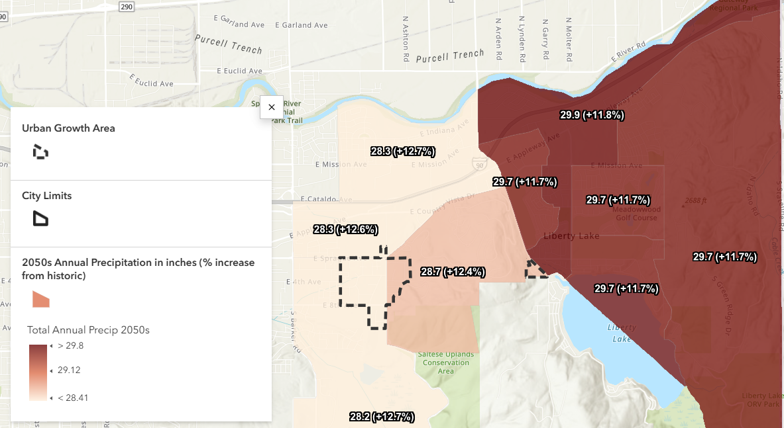
CHANGES IN PRECIPITATION - PROJECTIONS
Overview
Increased annual precipitation​
  About an average of 12%
More extreme seasonal variation​
While annual precipitation is projected to increase, this rise will mainly occur during rainy season. Conversely, the already-dry summers are expected to become even drier.
CLIMATE PROJECTION | 2050 | 2080
Total annual precipitation (percent change) | 8% increase (5 to 14 %) | 15% increase (7 to 24 %)
Notes:
Compounded impacts of risk to more erosion between transition of summer to winter especially with increased fire risk. Urban flooding more prevalent in areas with low tree canopy and high impervious area. Spokane Valley-Rathdrum Prairie Aquifer reduced snowpack after April 1st changes the recharge regime in the late 21st century. Spokane County looking at some wells

Slide 12
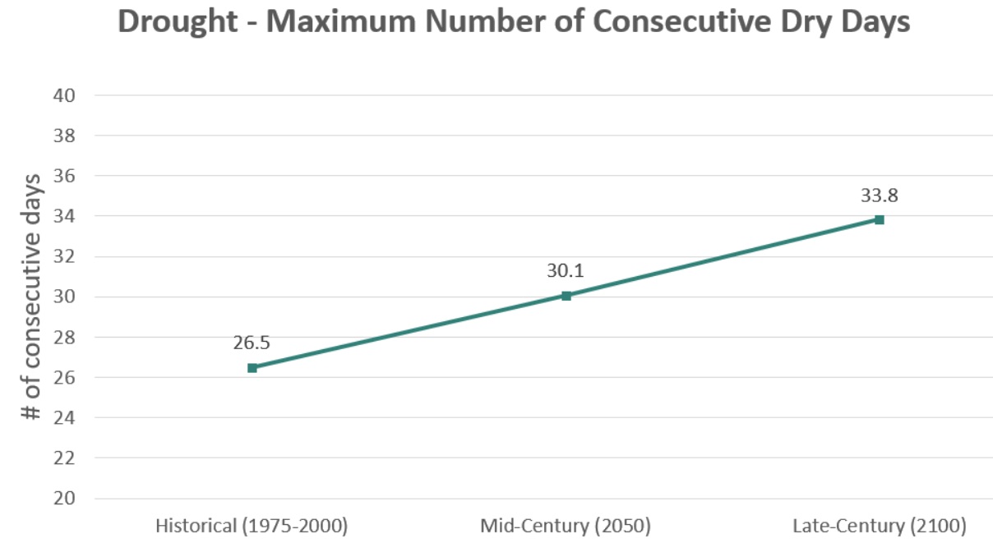
CHANGES IN PRECIPITATION - PROJECTIONS
Increase in drought
CLIMATE PROJECTION | 2050 | 2080
Late summer precipitation | 10% decrease (-25% - +8%) | 8% decrease (-31% - +30%)
Notes:
Compounded impacts of risk to more erosion between transition of summer to winter especially with increased fire risk. Urban flooding more prevalent in areas with low tree canopy and high impervious area. Spokane Valley-Rathdrum Prairie Aquifer reduced snowpack after April 1st changes the recharge regime in the late 21st century. Spokane County looking at some wells

Slide 13
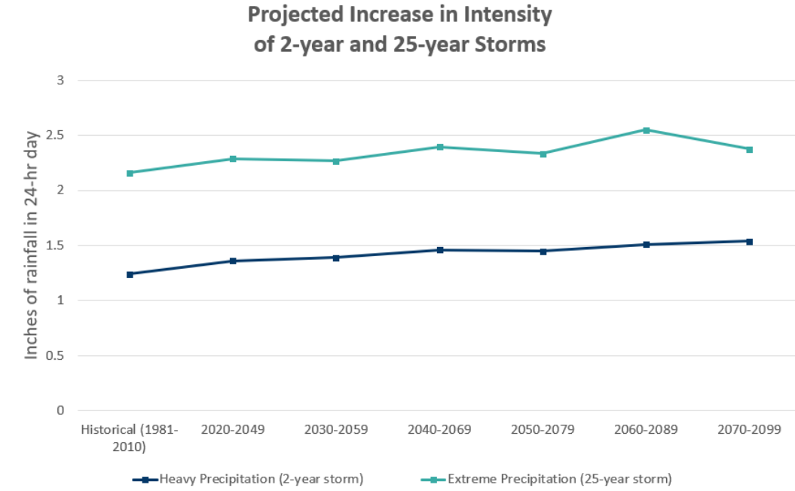
CHANGES IN PRECIPITATION - PROJECTIONS
Increase in extreme precipitation
CLIMATE PROJECTION | 2050 | 2080
Change in 24-hour 25 –year precipitation | 9% increase (0-24%) | 18% increase (11-46%)
Notes:
Compounded impacts of risk to more erosion between transition of summer to winter especially with increased fire risk. Urban flooding more prevalent in areas with low tree canopy and high impervious area. Spokane Valley-Rathdrum Prairie Aquifer reduced snowpack after April 1st changes the recharge regime in the late 21st century. Spokane County looking at some wells

Slide 14
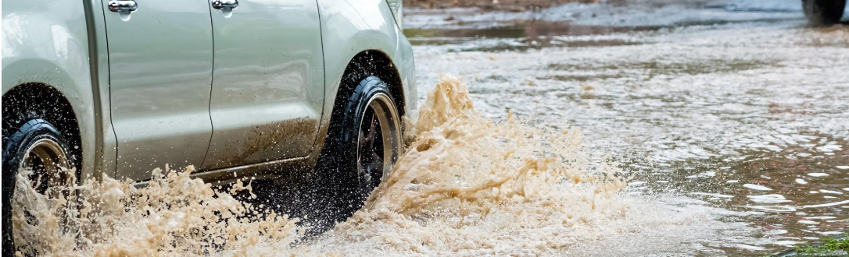
PRECIPITATION – COMPOUNDING HAZARDS
C
Flooding: urban flooding during winter.
Wildfires: increased risk of wildfire during dry season.
Erosion: erosion in fall post fire season.

Slide 15
PRECIPITATION – IMPACTS TO ASSETS
Transportation: flooding can impact major roads, accessibility, and travel safety
Stormwater management infrastructure: systems will need to accommodate increased intensity of precipitation. More stormwater impacts soil erosion, sediment transport,and increased runoff impairs water quality.
Environmental assets: increased drought conditions impact wildlife, vegetation, increase regional agricultural demand for water, increase wildfire danger.
Aquifer recharge: concerns for long-term resiliency of aquifer in light of changing precipitation patterns.
Notes:
Compounded impacts of risk to more erosion between transition of summer to winter especially with increased fire risk. Urban flooding more prevalent in areas with low tree canopy and high impervious area. Spokane Valley-Rathdrum Prairie Aquifer reduced snowpack after April 1st changes the recharge regime in the late 21st century. Spokane County looking at some wells

Slide 16
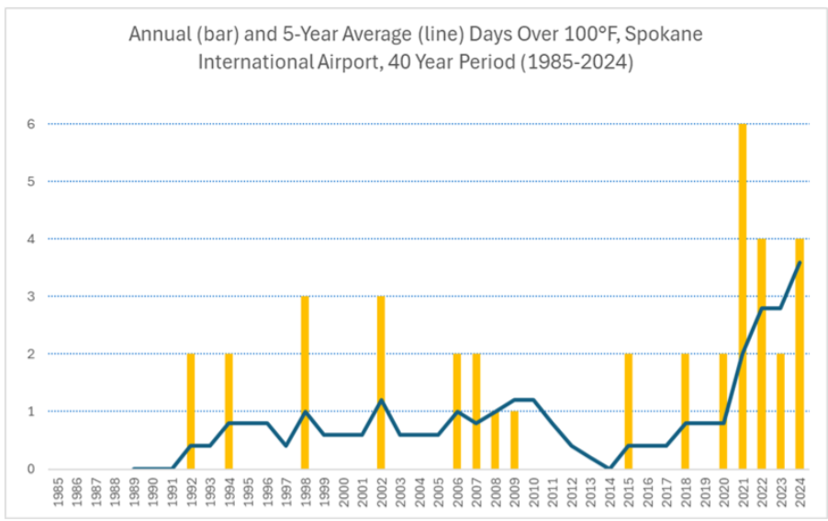
HEAT - PROJECTIONS
Overview
Days over 100 degrees is expected to become more common
  Expected to increase by 6-24 additional days
CLIMATE PROJECTION | 2050 | 2080
Change in Hot Days (over 100 °F). | 6 days (2 – 10) | 24 days (12 - 40)
90 Degree Max. Humidex (change in days) Historic 21 days | 23 days (11 - 34) | 55 days (34 - 77)
Notes:
Compounded impacts of risk to more erosion between transition of summer to winter especially with increased fire risk. Urban flooding more prevalent in areas with low tree canopy and high impervious area. Spokane Valley-Rathdrum Prairie Aquifer reduced snowpack after April 1st changes the recharge regime in the late 21st century. Spokane County looking at some wells

Slide 17
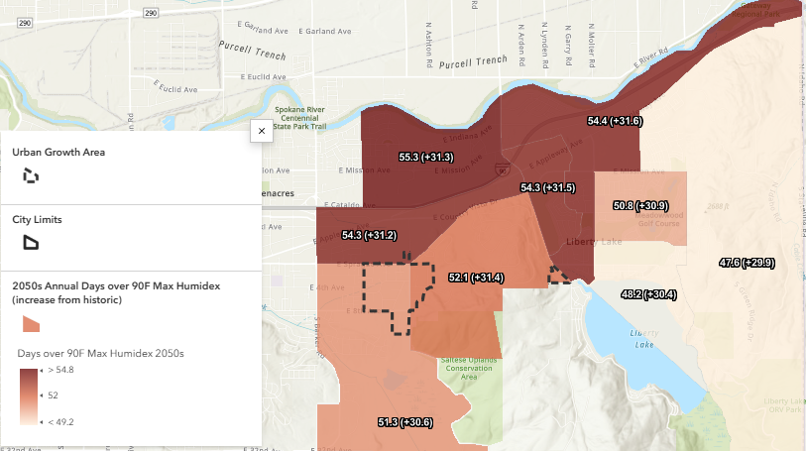
HEAT - PROJECTIONS
Increase in nighttime temperatures exacerbate heath impacts
CLIMATE PROJECTION | 2050 | 2080
65 Degree Min. Humidex (change in days) historic 5 days | 13 days (7 - 21) | 37 days (17 - 59)
Notes:
Compounded impacts of risk to more erosion between transition of summer to winter especially with increased fire risk. Urban flooding more prevalent in areas with low tree canopy and high impervious area. Spokane Valley-Rathdrum Prairie Aquifer reduced snowpack after April 1st changes the recharge regime in the late 21st century. Spokane County looking at some wells

Slide 18
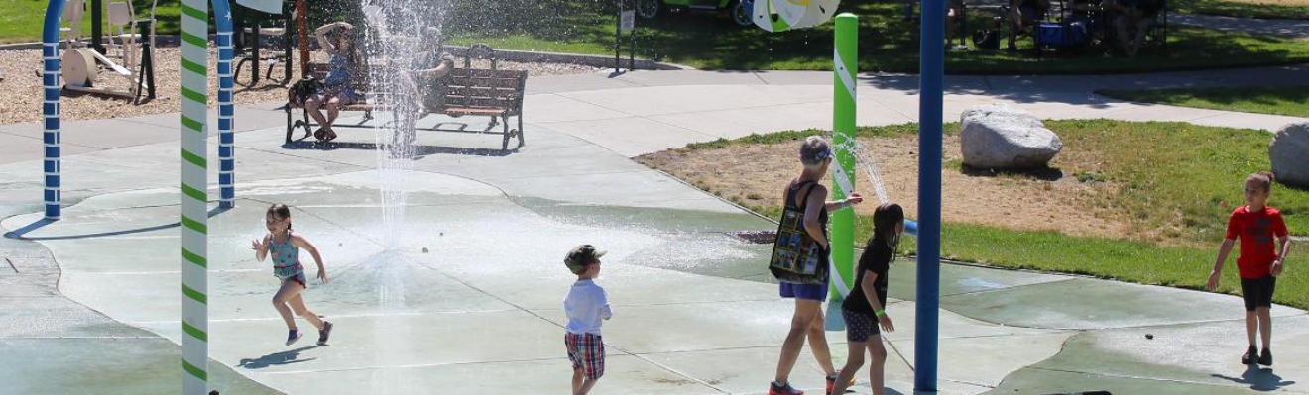
HEAT – COMPOUNDING HAZARDS
C
Drought Acceleration: heat accelerates drought conditions.
Wildfires: increased risk of wildfire during dry season.
More extreme precipitation: Heat increases frequency and extremity of rainfall.

Slide 19
HEAT – IMPACTS TO ASSETS
At-risk populations (age): Older adults and younger children are at higher risk of experiencing heat related illness
Environmental Assets: Extreme heat harms ecosystems and leading to widespread death (birds and fish). Drought conditions can damage forests, trees, and increase risk of wildfire.
At-risk populations (pre-existing conditions): Individuals with pre-existing health conditions at greater risk of experiencing heat related illness (COPD, heart disease, etc.)
Infrastructure: Heat can impact utility lines and transportation systems. High temperatures can cause roads to buckle, powerlines to melt, etc.
Notes:
Compounded impacts of risk to more erosion between transition of summer to winter especially with increased fire risk. Urban flooding more prevalent in areas with low tree canopy and high impervious area. Spokane Valley-Rathdrum Prairie Aquifer reduced snowpack after April 1st changes the recharge regime in the late 21st century. Spokane County looking at some wells

Slide 20
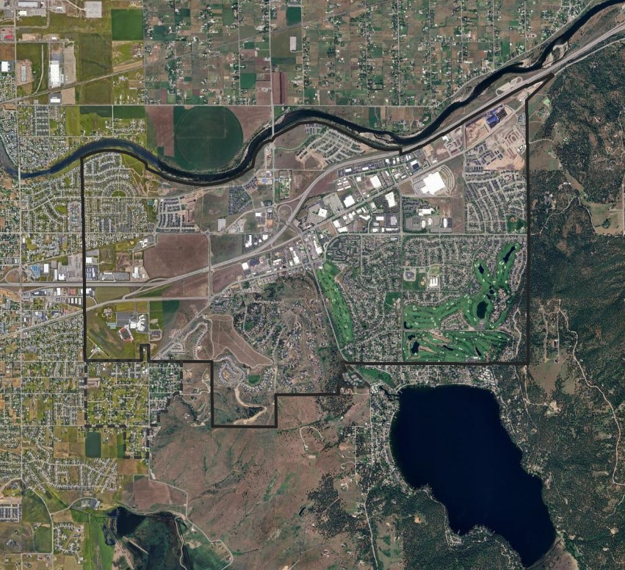
WILDFIRE - PROJECTIONS
Overview
  Regional impacts from wildfire smoke and increase in high-fire danger days
  Increased drought will prolong high fire danger days into the future
  The interface between the built environment and forest, steppes and grassland increasing threat for wildfire.
Notes:
The INTERFACE is often found along the outskirts of urban area. The WILDLAND-URBAN INTERFACE is defined as those areas where human development MEETS areas that are covered with more than 50% wildlands. To be considered INTERFACE, development/structures must be bordered by wildlands on at least one side.
WILDLAND-URBAN INTERMIX are those areas where structures intermingle with wildlands. To be considered intermix, a development OR structure must be surrounded on 2 or more sides by wildlands. INTERMIX is often found between the INTERFACE and the WILDLANDS.
The Wildland-Urban Interface, or WUI, is not the same as wildfire risk. As such, the Wildland-Urban Interface map can be used as a TOOL to help define wildfire risk.

Slide 21
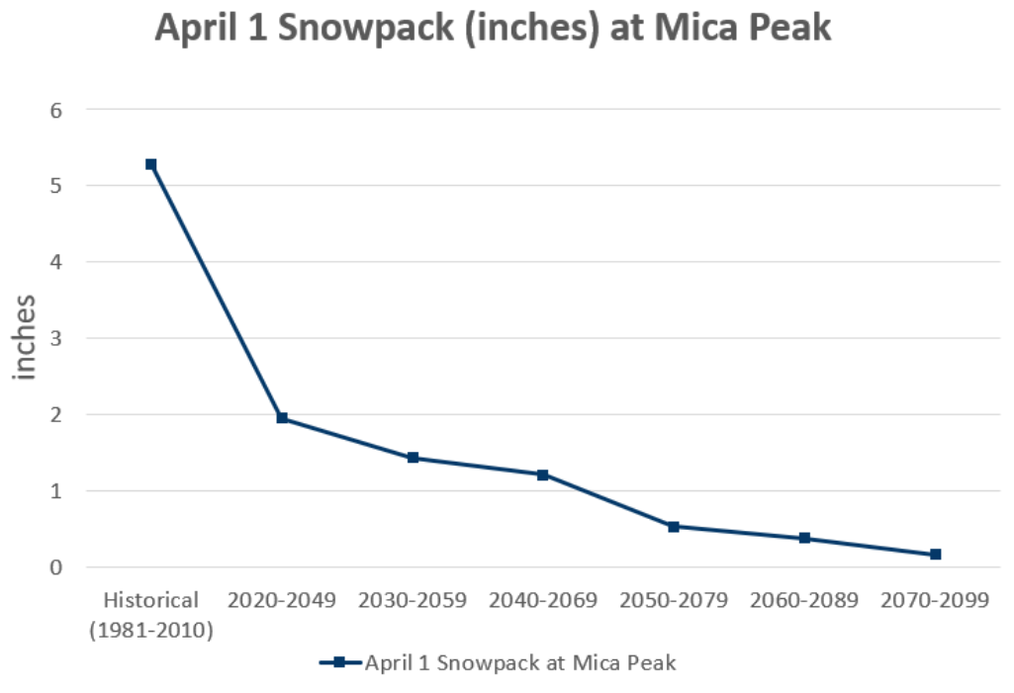
WILDFIRE - PROJECTIONS
Decreased snowpack
  Snowpack essential for keeping forests moist during dry season, preventing wildfire
  Anticipating 97% less
  April 1st snowpack at Mica Peak
Notes:
The INTERFACE is often found along the outskirts of urban area. The WILDLAND-URBAN INTERFACE is defined as those areas where human development MEETS areas that are covered with more than 50% wildlands. To be considered INTERFACE, development/structures must be bordered by wildlands on at least one side.
WILDLAND-URBAN INTERMIX are those areas where structures intermingle with wildlands. To be considered intermix, a development OR structure must be surrounded on 2 or more sides by wildlands. INTERMIX is often found between the INTERFACE and the WILDLANDS.
The Wildland-Urban Interface, or WUI, is not the same as wildfire risk. As such, the Wildland-Urban Interface map can be used as a TOOL to help define wildfire risk.

Slide 22
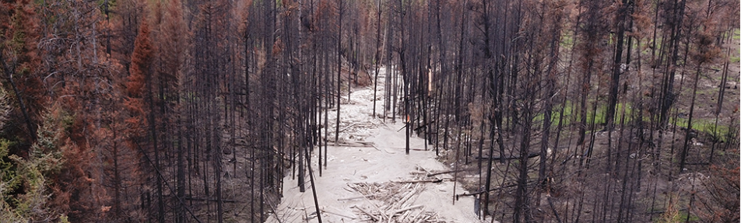
WILDFIRE – COMPOUNDING HAZARDS
C
Increased flood risk: burned areas absorb less water, increased flood risk post burn with more intense precipitation.
Increased landslides: burned areas destabilized, increased landslide risk and debris flows.
Wildfire smoke: smoke from wildfires pollutes the air and pose health risks to residents.

Slide 23
WILDFIRE – IMPACTS TO ASSETS
Residents/Residential Housing: Wildfires may go through residential areas, impacting residents, homes, insurance costs, and property values. Need for evacuation routes and emergency management plans.
Impacts to health: Wildfires increase exposure to wildfire smoke and impact health of residents and surrounding communities.
Economic/Infrastructure Impacts: Wildfires can destroy critical infrastructure, such as powerlines, roads, water systems. Events may disrupt access to services and disrupt work.
Environmental Assets: Wildfires destroy ecosystems. Burn scars decrease snowpack, increase runoff, degrade water quality, impact recreational facilities.
Notes:
Compounded impacts of risk to more erosion between transition of summer to winter especially with increased fire risk. Urban flooding more prevalent in areas with low tree canopy and high impervious area. Spokane Valley-Rathdrum Prairie Aquifer reduced snowpack after April 1st changes the recharge regime in the late 21st century. Spokane County looking at some wells

Slide 24
CREATING A VISION STATEMENT
Develop a vision statement describing the social, economic, and environmental places, traditions, and values that matter most to the Liberty Lake community.
Notes:
Maddie
From the charter, one of the CPAT’s responsibilities is to:
“Develop a “vision statement” describing the social, economic, and environmental places, traditions, and values that matter most to the Liberty Lake community.”
Whiteboard brainstorming activity – have people popcorn ideas, group ideas loosely
Places
Traditions
Values
Other

Slide 25
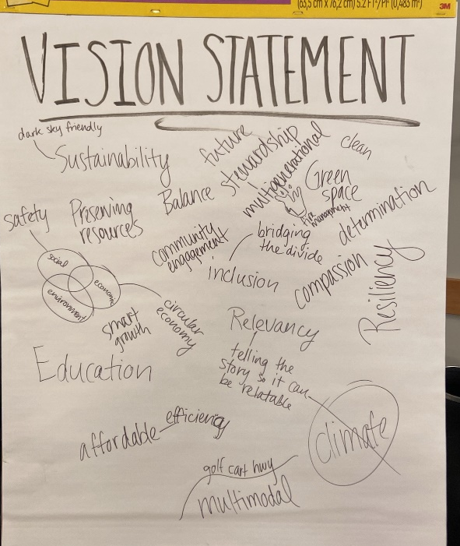
Agenda
Vision Statement Development
Themes from last time:
Environmental consciousness
Community and inclusivity
Future-oriented and innovative
Safety and resilience
Education and awareness
Economic and social factors
Notes:
Maddie
Environmental consciousness: Words like "Dark sky friendly," "Sustainability," "Green space," "Fire management," and "Preserving resources" highlight the importance of environmental stewardship and sustainability.
Community and inclusivity: Terms like "Multigenerational," "Compassion," "Community engagement," "Inclusion," and "Bridging the divide" emphasize the focus on creating a welcoming and inclusive community for all.
Future-oriented and innovative: Words such as "Future," "Smart growth," "Circular economy," and "Efficiency" indicate a forward-thinking approach to development and growth.
Safety and resilience: Phrases like "Safety," "Resiliency," and "Balance" underscore the importance of safety and the ability to adapt and thrive in changing conditions.
Education and awareness: "Education," "Telling the climate story in a way that people can relate to," and "Talking about climate without talking about climate" suggest a focus on raising awareness and educating the community about important issues.
Economic and social factors: "Affordable," "Intersection of social, environmental, and economic factors," and "Relevancy" highlight the need to balance various aspects of community life.

Slide 26
Agenda
Vision Statement Development
Sample 1
The CPAT envisions an environmentally conscious, inclusive, and future-oriented Liberty Lake community that prioritizes smart growth, resilience, and affordability in order to thrive now and for generations to come.
Sample 2
The Liberty Lake CPAT envisions a future where environmental consciousness, inclusivity, and innovation drive our community's growth. We prioritize sustainability, smart growth, and resilience, ensuring a balanced and connected community for all.
Notes:
Maddie

Slide 27
NEXT STEPS
Notes:
Next CPAT meeting – date and what will be covered

Slide 28
THANK YOU!

