Slide 1


Liberty Lake 2026 Comprehensive Plan & Climate Element Update
Note – images sourced as “Courtesy” may need request if used for final document…other images from 2016 Comp Plan

Slide 2
Agenda
Agenda
GHG Emissions Sub-element Discussion -20 min
Q&A - 40 min
Notes:
Introductions and brief element updates (round-robin)
Overview of Climate Element Process (MAKERS)
GHG Emissions Sub-element Discussion (Parametrix)
GHG Inventory – What it covers, etc.
Key findings
Resilience Sub-element (MAKERS/ Parametrix on water resources and data questions...)
Overview of sub-element – key goals and minimum requirements
Review the draft assets - Discuss and gather feedback.
Review initial consequences and priority hazards. Discuss and gather feedback.
Next steps
Future meetings and coordination with staff – confirm timeline and steps
Upcoming events: CPAT, Fall public meeting – coordination opportunity
Future work on goals and policies and element content – crosswalk follow-up on the Audit...

Slide 3
OVERVIEW OF CLIMATE ELEMENT

Slide 4
What is the “Climate Element”?
What is the “Climate Element”?
RCW 36.70A.070 Comprehensive plans—Mandatory elements. “A climate change and resiliency element that is designed to result in reductions in overall greenhouse gas emissions and that must enhance resiliency to and avoid the adverse impacts of climate change, which must include efforts to reduce localized greenhouse gas emissions and avoid creating or worsening localized climate impacts to vulnerable populations and overburdened communities.” https://app.leg.wa.gov/RCW/default.aspx?cite=36.70A.070&pdf=true
Washington State now requires planning for climate change in the Comprehensive Planning process.
Climate Element includes two sub-elements
GHG Emissions Reduction sub-element
Resilience sub-element
Communities are also required to advance environmental justice and avoid environmental health disparities.
Notes:
KATY
This is mostly a background slide, and I included this at the open house that many of you attended.
They key information here is that for Anacortes, both the GHG emissions and the Resilience subelement are required.
There are also new requirements to meet environmental justice goals, and reduce impacts for vulnerable populations and overburdened communities.
We are in the process of forming a Climate Policy Advisory Team (CPAT) which will help guide the development of the Climate Goals and policies. We are working to include members that are part of or work with these populations in Anacortes – the CPAT will be one of the primary ways we ensrure alignment with those EJ goals.
We are also happy to discuss EJ goals with staff at these meetings.

Slide 5
Process Overview
GHG inventory
Analysis/ Assessment
Data Gathering
Identify emissions reduction targets
Establish Goals
Plan Integration
Climate Element goals/policies
Integrated Comprehensive Plan
GHG Emissions Sub-element
Assess impacts and review existing plans
Assess vulnerability
Resilience Sub-element
Other Comprehensive Plan Elements
Updates to other comprehensive plan elements
Engagement
Community engagement activities at key points throughout the process
Notes:
KATY
We shared this slide at the Open House, and while it simplified the process somewhat, I do think it shows how we are working towards a goal of an integrated final comprehensive plan document.
Right now the Climate Element is transitioning between data gathering and analysis – those steps are somewhat iterative.
While we will have separate climate goals/policies within the climate element, we'll also want to work with you at that stage...if we wait until the end, integrating the final document will be much more challenging and complex.
Commerce also allows flexibility on the format for the Climate Element – it can be either a separate chapter, or a dedicated element. Right now, we think that it will make sense to take something of a hybrid approach – have a dedicated element, but also a strong system of cross-referencing so goals and policies that support or relate to the climate element are easy to find.

Slide 6
GHG EMISSIONS SUB-ELEMENT

Slide 7
What is a GHG inventory?
Accounting of greenhouse gases (GHGs) emitted to or removed from the atmosphere during a specified period for an organization or geographic boundary.
GHGs are in large part from the combustion of fossil fuels, but also include emissions from other sources like refrigerants, wastewater treatment, waste disposal, and land use change.
GHG inventories provide an emissions baseline and a means to track emissions reductions over time and progress toward goals.
Greenhouse Gas | Chemical Formula | Global Warming Potential (GWP)
Carbon Dioxide | CO₂ | 1
Methane | CH₄ | 28
Nitrous Oxide | N₂O | 265
Other high-GWP gases | CFCs, HFCs, SF₆, etc. | up to 24,000
Source: IPCC 5th Assessment Report, 2014, 100-year values
Notes:
Make sure to mention that this is a mandated element

Slide 8
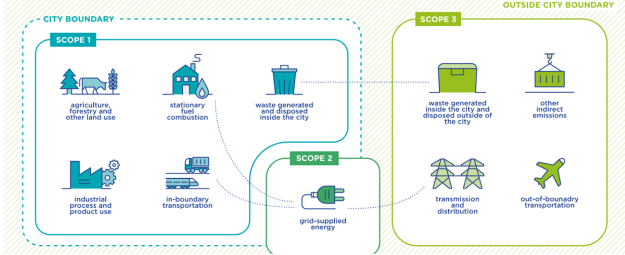
What’s included?
Includes activities within calendar year 2022
Activities within the city’s geographic boundary
Follows Washington State Department of Commerce requirements
Includes all residential energy sources, transportation, waste, and the conversion of land to make the city in the first place.
Notes:
This is based on the Global Protocol for Communities put out by the IPCC

Slide 9
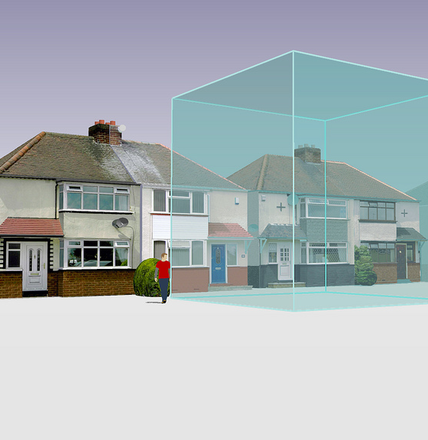
What is 1 MT CO₂e?
A Metric Ton of Carbon Dioxide Equivalent – a way to normalize GHG gases to CO₂.
One MT CO₂e is equal to any one of the following:*
One passenger vehicle driven 2,500 miles
13% of one US home’s energy use for a year
46 propane cylinders for home BBQs
1.2 acres of forest sequestration for 1 year
*Calculated using EPA’s GHG Equivalencies Calculator

Slide 10
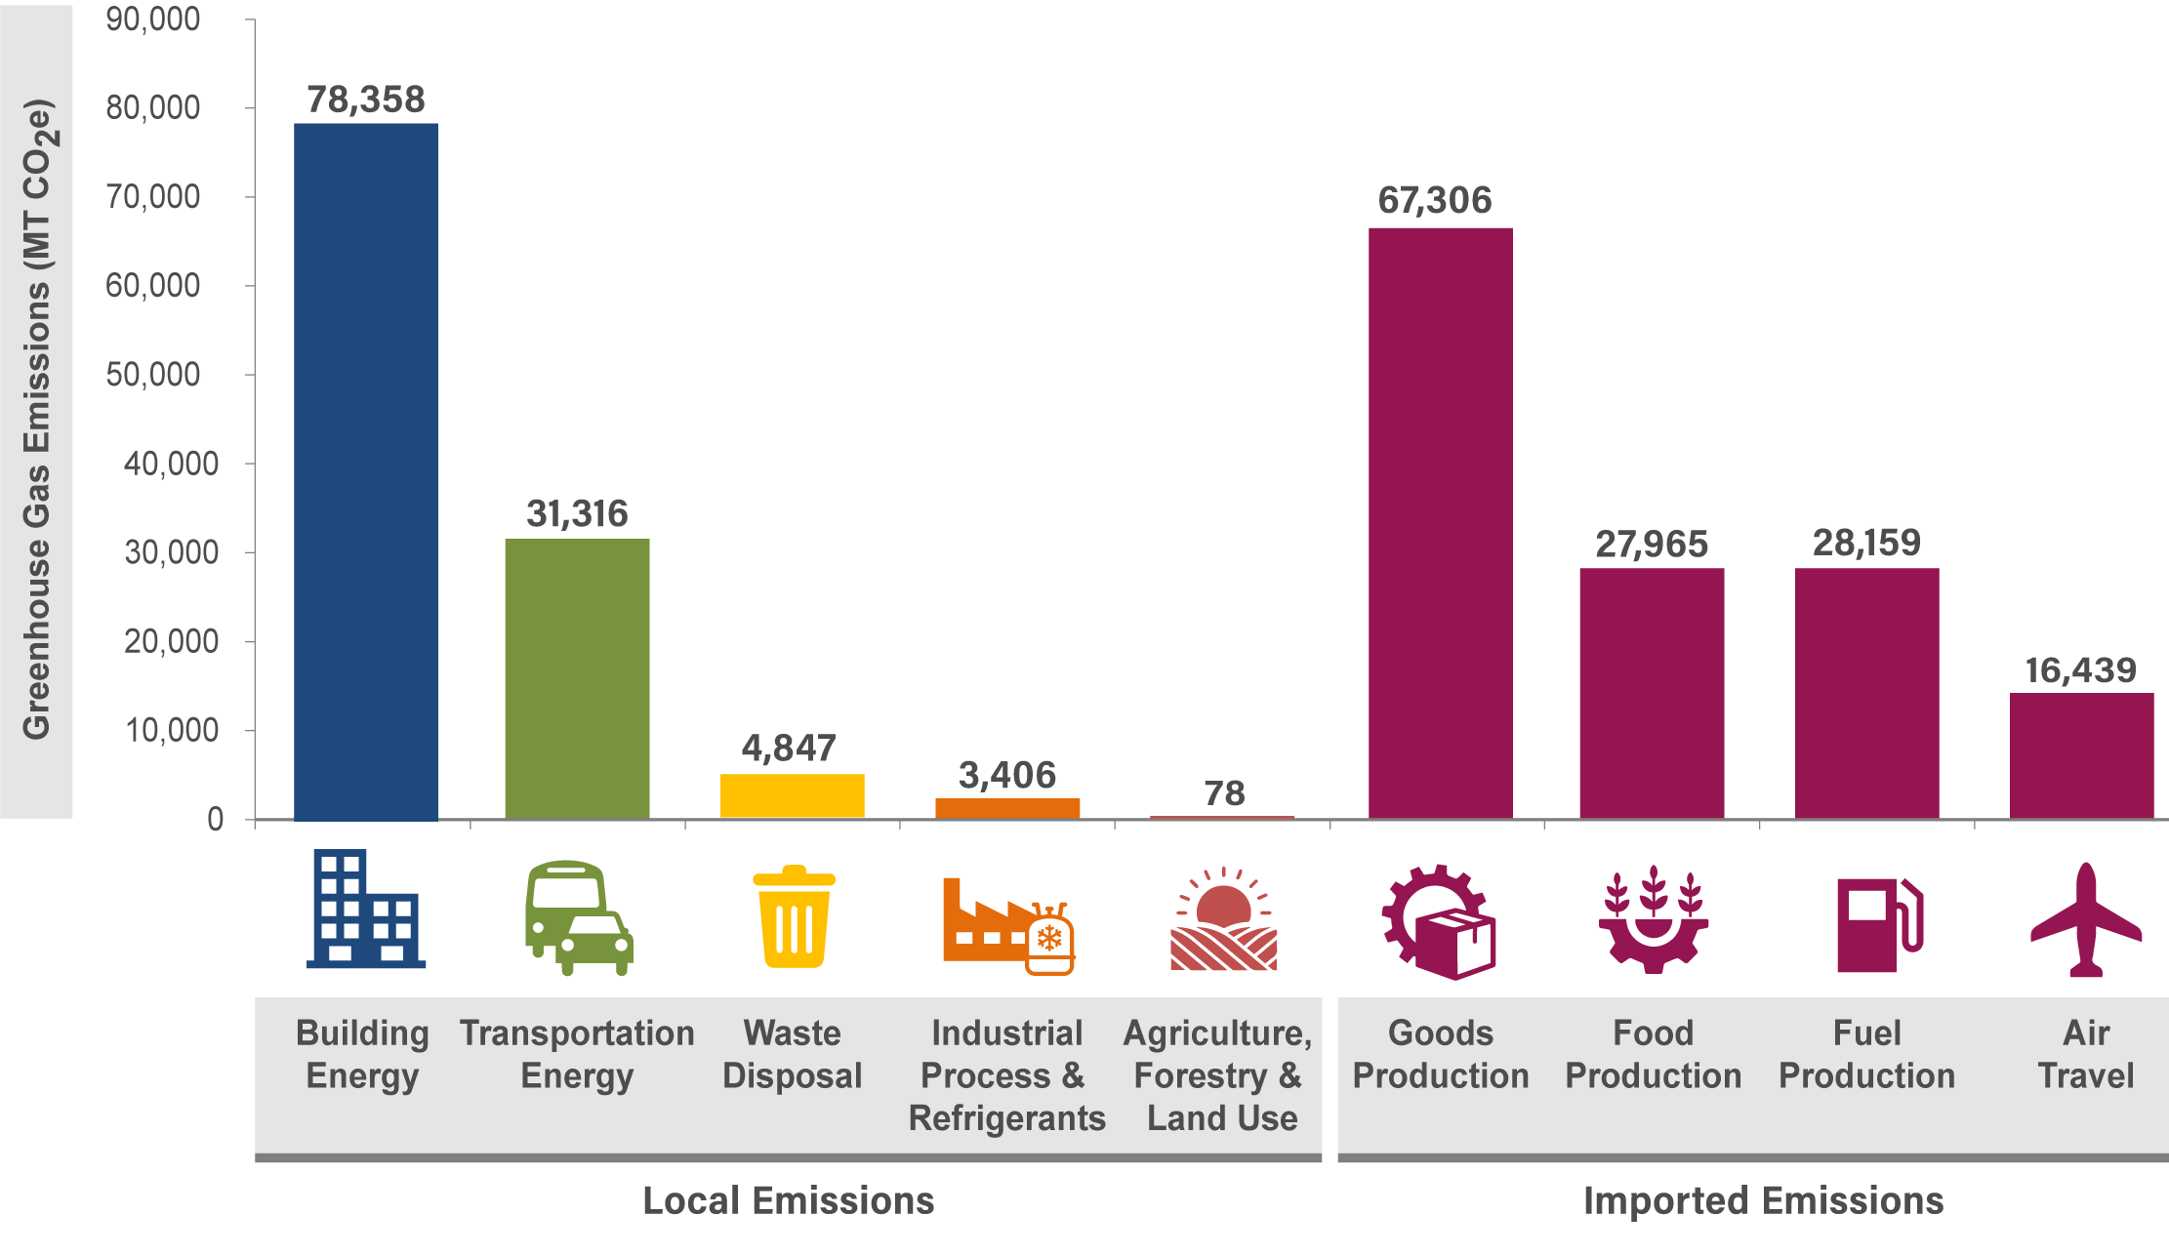
Overall Results for 2022: 257,875 MT CO₂e

Slide 11
Per-Capita Comparison—Local Emissions
Liberty Lake is primarily residential:
No Industrial
No Agricultural
Not a lot of outside traffic coming in
Notes:
The state of Washington’s GHG inventory

Slide 12
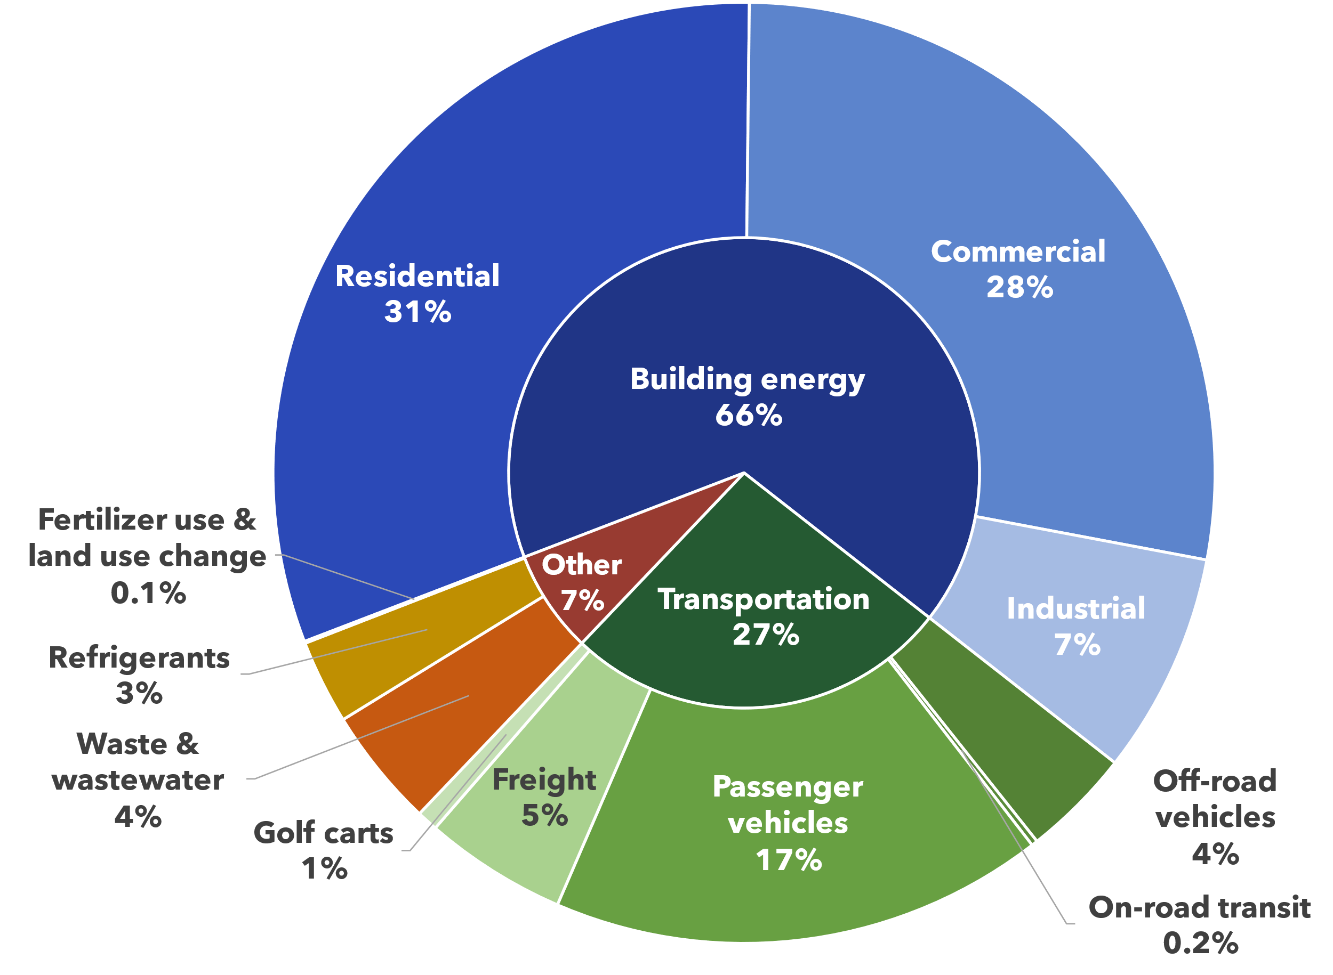
Overall Results—Local Emissions

Slide 13
Building Energy (66%)
Includes any energy used in buildings, including:
Lights
Heat/Cooling
Appliances
Data Sources for building energy emissions:
Electricity (38%)
Avista Energy
Utility Bills
Solar decreases usage
Renewable Energy Credits (RECs) subtracted from total
Electric vehicle (EV) electricity included in Transportation
Natural Gas (24%)
Avista Natural Gas
Utility Bills
Other (4%)
Propane
Diesel
Estimated based on state averages

Slide 14
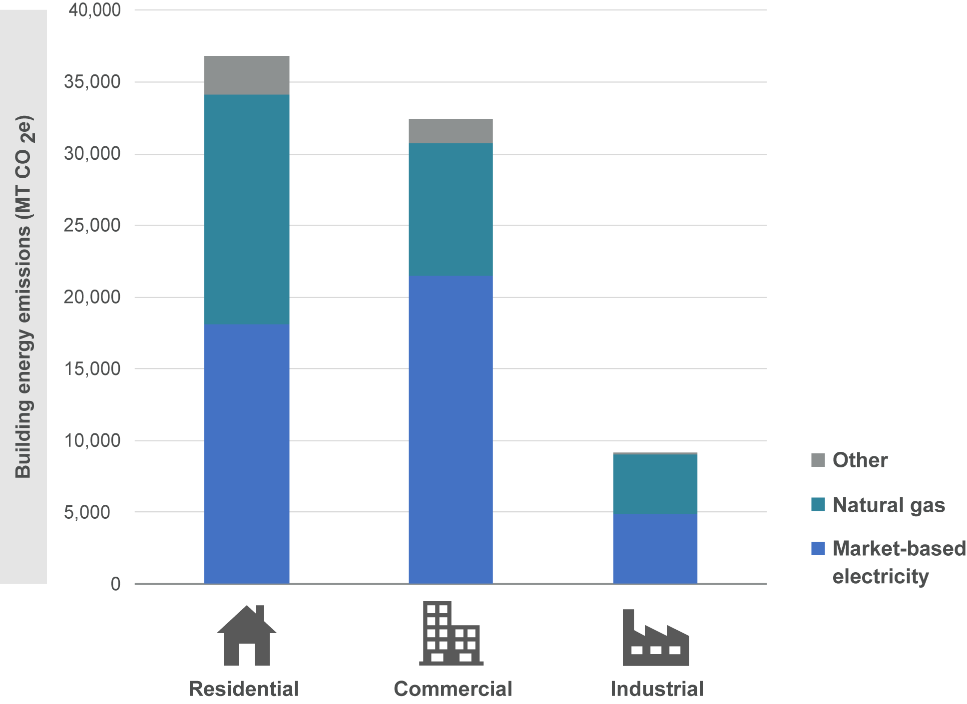
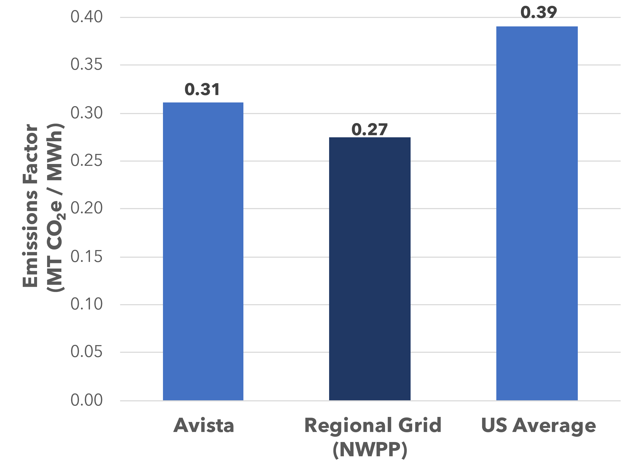
Building Energy (67%)
Emissions Factors – Market- vs Location-Based
Avista Energy is in line with the regional average
Notes:
Maybe cut the location based

Slide 15
Transportation Energy (27%)
Includes any energy that fuels transportation
Passenger Cars
Freight
*No significant rail
Data Sources for transportation emissions:
Passenger Cars and Freight (22%)
Replica software – Vehicle miles traveled (VMT) estimate from cell phone data
Passenger car population from DMV
Department of Energy fuel efficiency estimates
Spokane Transit Fuel Usage
Golf Carts (1%)
Golf course estimates
Number of carts
Fuel budget
City registered golf carts
Off Road (4%)
Lawnmowers
Construction Equipment
ATVs
Estimated from statewide inventory
Notes:
A lot of this comes from AFLEET – This is really a tool designed to help government agencies understand when it’s time to buy new vehicles, when is it cost effective is the biggest thing that they focus on

Slide 16
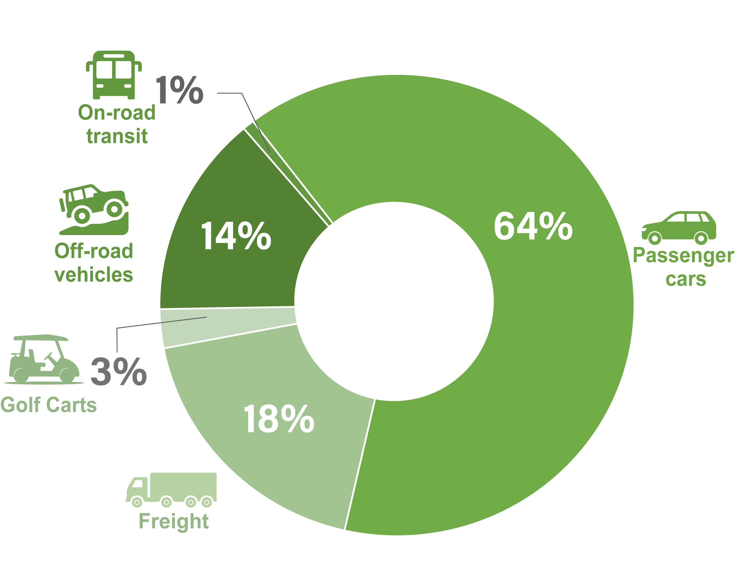
Transportation Energy (27%)

Slide 17
Waste and Refrigerants (7%)
Includes the following:
All community refrigerant use
Landfilled waste
Water treatment/process emissions
Data Sources for waste and refrigerant emissions:
Refrigerants (3%)
Air Conditioners
Cars
Refrigerators
Industrial Cooling
Downscaled from EPA data
Solid Waste (1%)
Garbage collected in the city
Taken to Greater Wenatchee Landfill
Proportion of landfill’s emissions based on tons of waste
Compost Emissions
Wastewater (3%)
Local Wastewater Treatment
Out of Town Wastewater Treatment
Estimated by EPA’s community inventory tool
N₂O emissions
CH₄ emissions
Notes:
Refrigerants Freon replaced with R410 “Pureon”
Talk about compost here—There are emissions associated with Compost, but they are less than it would be to landfill an equivalent quantify of waste, and although those emissions are associated with your community, they are also offset

Slide 18
Land Use and Land Use Change (0.1%)
Includes the following:
Golf course fertilizer use
Historical emissions from development
Data Sources for land use emissions:
Fertilizer Use (<0.1%)
Golf course reported fertilizer usage
N₂O emissions per ton of N fertilizer
Development (<0.1%)
Previous area assumed to be rangeland
Emissions per acre from EPA factors
Split up over 20 years.
Last inventory to count

Slide 19
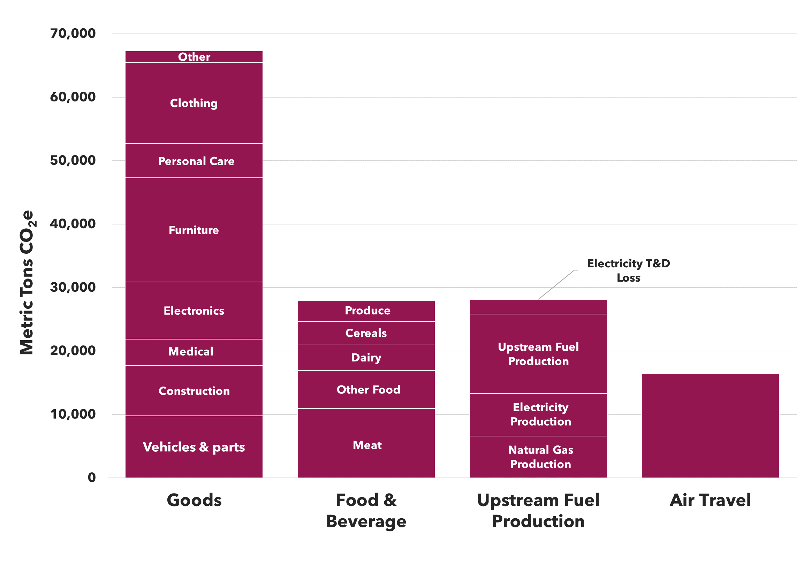




Imported Emissions: roughly equal to local
Food, Goods, and Air Travel based on income
Data Source: US Census
Data Source: Berkeley CoolClimate Calculator
Fuel production based on electricity, natural gas, gasoline, and diesel usage
Data Source: State-wide and national fuel production averages

Slide 20
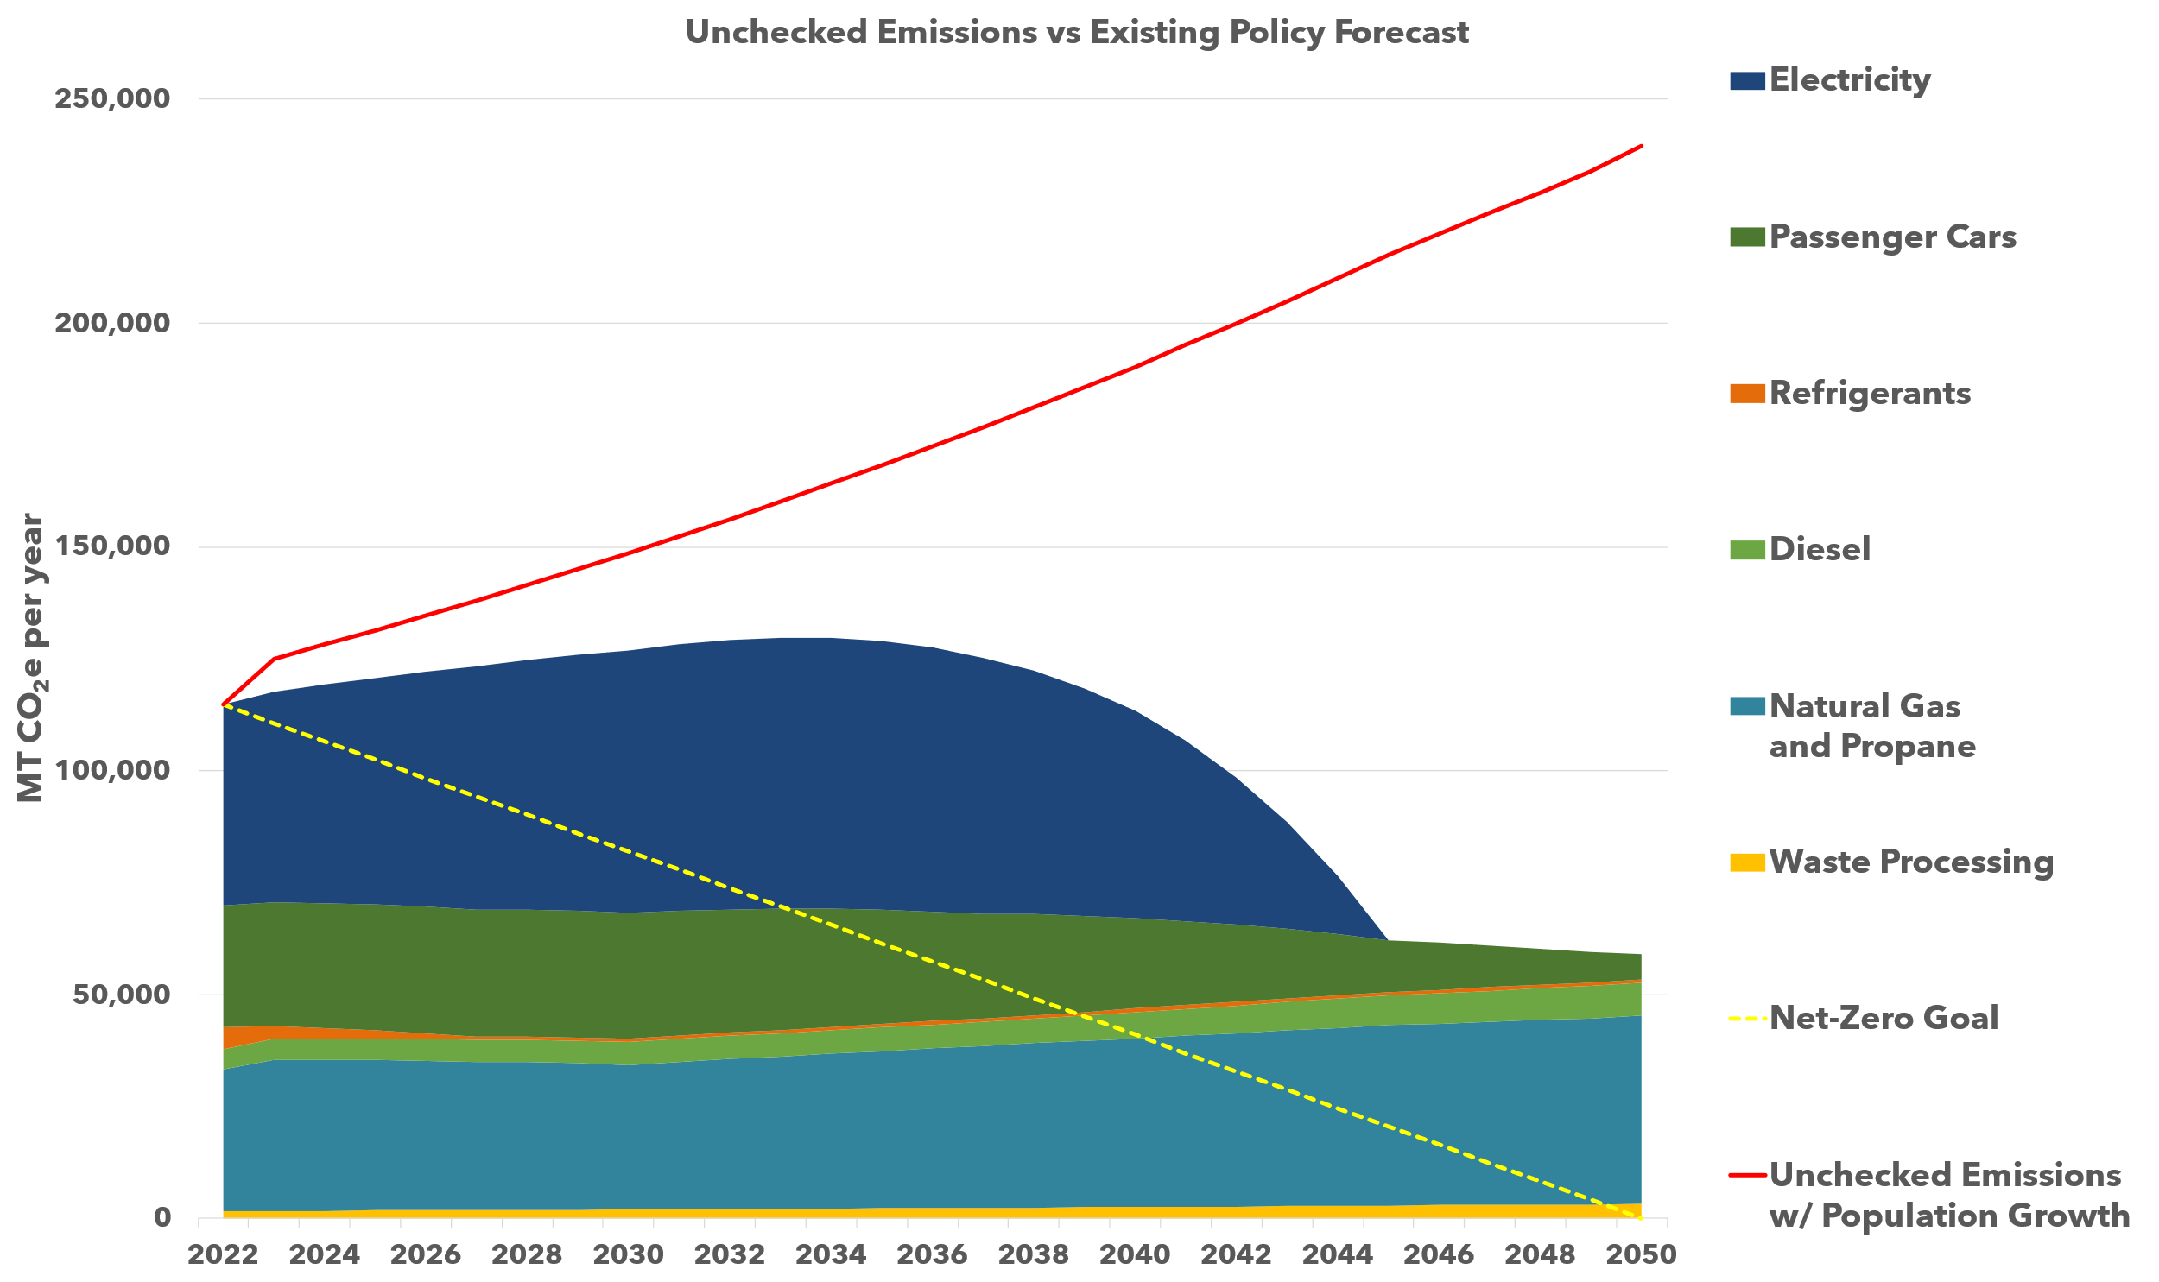
Emissions Forecast: Fast Growth vs. Reductions
Recent growth exceeds growth projections
Electricity: Washington Clean Energy Targets require Electricity emissions go to zero by 2040
Electricity and Natural Gas: Clean Buildings act requires increases in building efficiency
Fuels: Clean Fuels Standards require transportation fuel emissions decrease by 20% by 2034
Passenger cars: All new cars sold must be EVs by 2035
Refrigerants: State of Washington HFC Rules phase out high GWP chemicals

Slide 21
Next Steps

Slide 22
Process Overview
GHG inventory
Analysis/ Assessment
Data Gathering
Identify emissions reduction targets
Establish Goals
Plan Integration
Climate Element goals/policies
Integrated Comprehensive Plan
GHG Emissions Sub-element
Assess impacts and review existing plans
Assess vulnerability
Resilience Sub-element
Other Comprehensive Plan Elements
Updates to other comprehensive plan elements
Engagement
Community engagement activities at key points throughout the process
Notes:
KATY
We shared this slide at the Open House, and while it simplified the process somewhat, I do think it shows how we are working towards a goal of an integrated final comprehensive plan document.
Right now the Climate Element is transitioning between data gathering and analysis – those steps are somewhat iterative.
While we will have separate climate goals/policies within the climate element, we'll also want to work with you at that stage...if we wait until the end, integrating the final document will be much more challenging and complex.
Commerce also allows flexibility on the format for the Climate Element – it can be either a separate chapter, or a dedicated element. Right now, we think that it will make sense to take something of a hybrid approach – have a dedicated element, but also a strong system of cross-referencing so goals and policies that support or relate to the climate element are easy to find.

Slide 23
Set Goals, Develop Policies
Develop goals and policies to support the following:
Reducing building energy/increasing efficiency
Smart growth policies
Reduce diesel emissions
Support EV transition
Support clean electricity
Reduce reliance on natural gas
Reduce reliance on passenger vehicles

Slide 24
THANK YOU!

